Slide 1
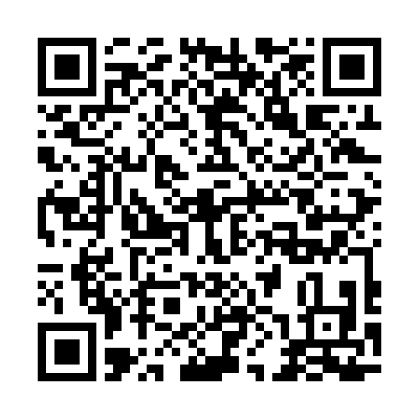


WELCOME!
Scan the code to fill out our quick survey before we get started.
DO GOOD. BETTER.

Slide 2
KICKOFF

Slide 3
TO
NIGHT
01
Welcome! Business for Good Intro
02
Meet the Ballard Center
03
Merit Medical Introduction
04
Case Intro
05
Rules, timeline & prizes
Q&A

Slide 4
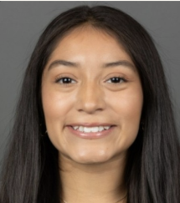
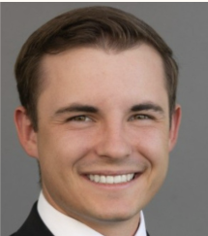
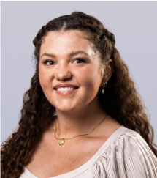
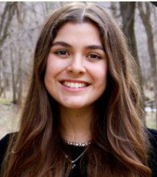
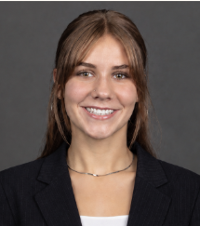
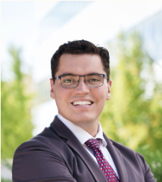
WHO WE ARE
BUSINESS FOR GOOD TEAM
VIENNA
MAKAY
EMMA
OLIVIA
CLEO
SEAN
Co-President
Co-President
Association / Events
MBA Strategy
Case Writer
Entrepreneurship
Notes:
Quick intro to the six of us and what each person owns on the team.

Slide 5
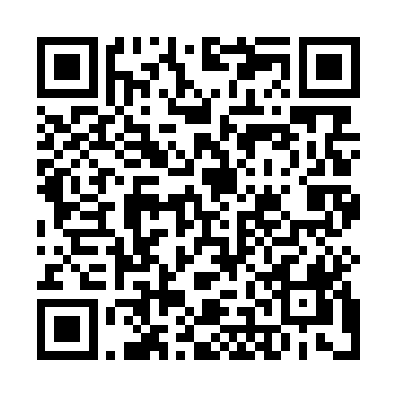

BUSINESS
FOR GOOD
Scan here to join our association
Empowering BYU students to use business as a force for doing good.

Slide 6
OUR MISSION
We use the power of business and markets to address complex global problems.
BUSINESS FOR GOOD

Slide 7
We live in a world where business creates and deploys value to improve the world.
OUR
VISION
BUSINESS FOR GOOD

Slide 8
JACOB 2:18-19
18 But before ye seek for riches, seek ye for the kingdom of God.
19 And after ye have obtained a hope in Christ ye shall obtain riches, if ye seek them; and ye will seek them for the intent to do good–to clothe the naked, and to feed the hungry, and to liberate the captive, and administer relief to the sick and the afflicted.

Slide 9
DO GOOD. BETTER.
What is social impact?
Sustainability
INCREASE HUMAN
FLOURISHING
Food security
Homelessness
Healthcare access
Humanitarian work
DECREASE HUMAN
SUFFERING
Poverty alleviation

Slide 10
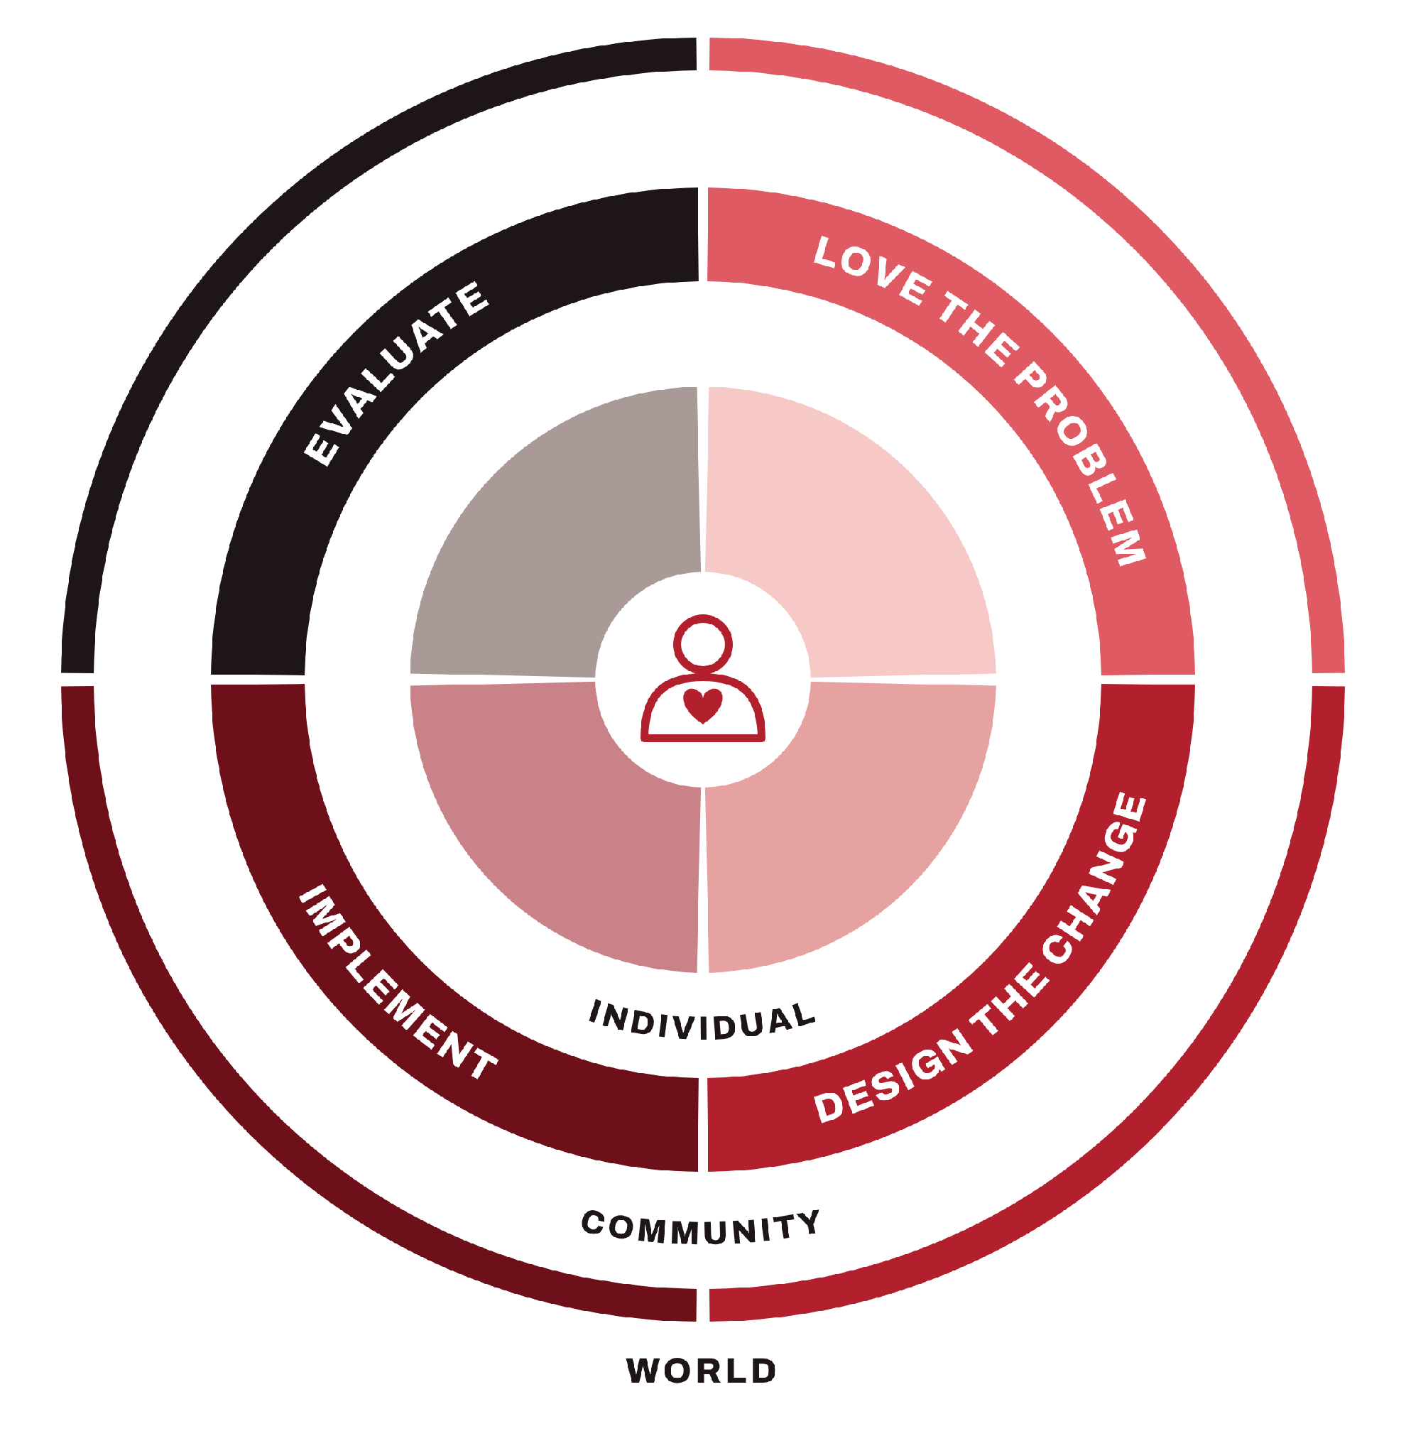
THE
SOCIAL
IMPACT
CYCLE
BUSINESS FOR GOOD

Slide 11
The Social Impact Journey…
Offsets / philanthropy
Unmitigated harm
(Relatedness)
Socially strategic
Prosocial marketing
Internal initiatives
Mitigating harm
BUSINESS FOR GOOD

Slide 12
OUR PARTNER
7,100
Associates worldwide
$1.5B
Founded in 1987, Merit Medical Systems, Inc. is a leading manufacturer and marketer of proprietary disposable medical devices used in interventional, diagnostic and therapeutic procedures, particularly in cardiology, radiology, oncology, critical care and endoscopy. Merit serves client hospitals and physicians worldwide, and employs approximately 7,000 people worldwide.
Net sales in 2025
42
Countries in its supply base
Notes:
Who Merit is, in one breath. Stats are from the case (Exhibits 1 and 2, 2025 figures).

Slide 13
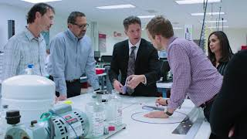
ABOUT MERIT MEDICAL

Slide 14
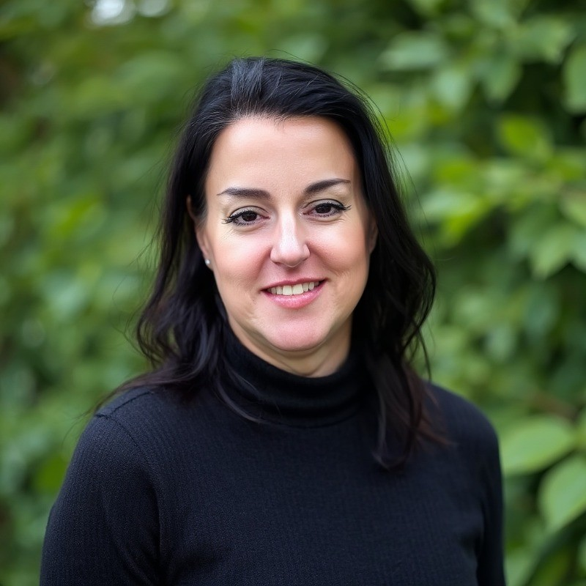
MEET OUR SPEAKER
Alisha Jerauld
VP, Environment, Social & Governance
Merit Medical Systems
Alisha has led Merit's global sustainability program since 2018, building its ESG reporting across 6 countries and advising the Board of Directors on ESG strategy.
40%
6
AA
2×
GHG intensity reduction
countries, 100% ISO 14001 certified
MSCI ESG rating
Newsweek's World's Greenest Companies

Slide 15
CASE
OVERVIEW

Slide 16
Case Context
Merit Medical is a global medical device manufacturer whose disposable devices are used in cardiology, radiology, oncology, and dialysis procedures.
Merit relies on ~1,030 direct suppliers in 42 countries. The top 78 hold ~65% of spend, and qualifying a replacement supplier takes 9–12 months.
Merit's HEART values already promise supplier standards, and its Board oversees ESG through a Governance and Sustainability Committee.
2026 is the final year of Merit's Continued Growth Initiatives: 5–7% growth, a 20–22% operating margin, and $400M+ in cumulative free cash flow.
In 2025, Merit earned three Newsweek sustainability recognitions and began routing suppliers through EcoVadis to score their sustainability performance.
Notes:
Set the stage: Merit makes disposable devices used in minimally invasive procedures, so supply continuity is a patient-safety issue. The supply base is big and concentrated, and switching suppliers takes most of a year. 2026 is the final year of Merit's public financial targets, so any plan has to respect margin and cash discipline.

Slide 17
Case Complications
Despite its awards, Merit's sustainability story is running ahead of its data.
Most suppliers have not completed EcoVadis. Gaps are widest at small manufacturers in Mexico and China with no sustainability staff or tracking systems.
These are the same regions Merit flags as highest-risk, and supply chain laws make supplier monitoring a compliance issue, not just a reputational one.
Scope 3 emissions are unmeasured and direct emissions rose, so promoting the awards risks claiming more than the data supports.
Any plan must fit Merit's margin and cash targets without straining the hard-to-replace suppliers that patients depend on.
Notes:
Two problems that have to be solved together. First, the supplier assessment is landing unevenly: the suppliers Merit knows least about are the small, hard-to-replace plants in Mexico and China. Second, the public story is ahead of the data. Saying nothing isn't an option either, because hospital customers screen suppliers on ESG. And all of this has to fit a six-week timeline and Merit's final-year financial targets.

Slide 18
Key Question
What supplier sustainability strategy should Merit adopt to build credible, verifiable data while strengthening the suppliers patients depend on?
Notes:
This is the question every team answers. Remind teams that Strategy A (mandate everyone) and Strategy B (top 78 first) in Exhibit 5 are starting points, not the answer.

Slide 19
What supplier sustainability strategy should Merit adopt to…
build credible, verifiable sustainability data across its global supply base,
strengthen the supplier relationships patients depend on,
and turn that progress into trust and competitive advantage with customers, investors, and employees,
…in a way that reflects Merit's values and fits its financial commitments?
Notes:
Full central question from the case, word for word. Read the lead-in, walk through the three goals, then land on the last line: whatever teams propose has to fit Merit's values and its financial commitments.

Slide 20
EVALUATION CRITERIA

Slide 21
HOW YOU'RE JUDGED
1
Strategic rationale & fit
4
Effective social impact
A clear, defended choice that advances Merit's top goal and reflects its vision, HEART values and financial commitments
Better outcomes for suppliers, workers and patients, without pushing out small suppliers or overstating progress
2
Feasibility & scalability
5
Operational considerations
Realistic strategies Merit could start this year and extend across a global supplier base
Detailed pilot design, process, owners, rollout timeline and risk mitigation
3
Quantitative rigor
6
Creativity & innovation
Recommendations backed by defensible data, with costs, returns and measurable targets
Novel, compelling ideas that align with Merit's mission
Notes:
Criteria are listed in order of importance, straight from the case.

Slide 22
RULES & DELIVERABLES

Slide 23

Teams of 3–5
ALL
MAJORS
WELCOME
students per team
Diversity in majors within teams
recommended but not required
Register by Thu, Oct 15
11:59 PM, using the team sign-up link
Case Published Fri, Oct 16
at 12:00am
Notes:
CONFIRM team size: 3–5 carried over from last year's competition; the Merit case doesn't state it.

Slide 24
SUGGESTED STRUCTURE
SLIDES
WHAT TO TURN IN
Recommendation & rationale
3–4
Your strategy and why it beats the alternatives
Implementation & pilot
2–3
Which suppliers first, steps, owners, timeline, support
Financials & metrics
2
10-minute presentation
5 minutes of judge questions
Costs, expected value, KPIs with numeric targets
Risks & mitigation
1–2
Biggest risks to suppliers, patients and Merit
Communication plan
1
What Merit shares, with whom, and greenwashing guardrails
Social Impact Cycle
1
Your strategy mapped onto the cycle
Notes:
Suggested deck structure from the case. CONFIRM the presentation length: 10 min + 5 min Q&A was last year's format.

Slide 25
SCHEDULE & PRIZES

Slide 26
THE ROAD
TO FINALS
TUE, OCT 13
THU, OCT 15
FRI, OCT 30
FRI, OCT 30
Kickoff
Teams due
Submissions due
Competition day
Find a team!
Register by 11:59 PM
Case posted at 12:00 AM
Decks in by 7:00 AM
Prelims & finals
Notes:
Fill in the bracketed dates before presenting.

Slide 27
COMPETITION DAY · FRI, OCT 30
COMPETITION DAY
Submission deadline: 7:00 AM
ROUND 1
ROUND 2
Prelims
Finals
9:30–11:45 AM
1:15–2:55 PM
Every team chooses a 20 minute slot
10 min presentation + 5 min Q&A
Top 5 teams advance
Winners announced by 3:45 PM
Check in at the TNRB atrium · Prelims in JKB · Finals in TNRB 710

Slide 28
CASH
PRIZES
1st
2nd
3rd
$2,000
$3,000
$1,000
Notes:
Prize amounts confirmed in the Merit case.

Slide 29
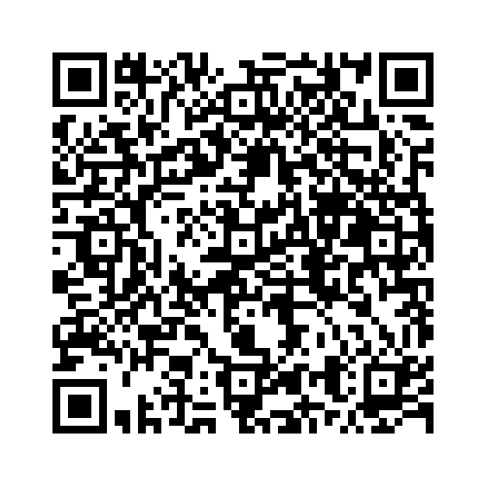
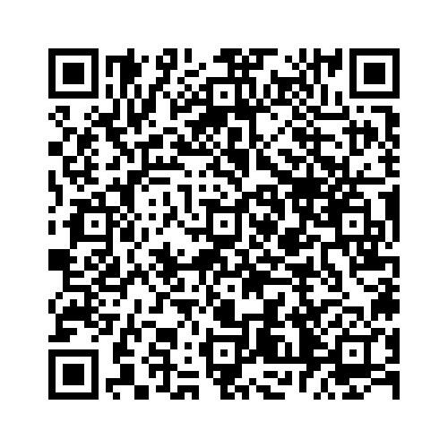
THANK
YOU
Scan if you need a team!
Team Sign Up Sheet
Register your team by Thursday Oct 15th @ 11:59pm
Questions? Email peerybfg@byu.edu

